Slide 1
Architecture
By:
Eric Augustine
Period 6 ap

Slide 2
Chapters 1-3

Slide 3
The anasazis
Lived in pueblos- Spanish for towns
Pueblos were clustered around central plazas with circular underground kivas.
Made canals flowing from mountain catchment bases
Stone and adobe dwellings built along cliff walls
Constructed with bricks made from sand, clay, and water with some fibrous or organic material
Known for their pottery
Pottery was used for cooking or storage
Pottery was usually painted black designs on white or light gray backgrounds

Slide 4
European Community’s
Rural Europeans lived in family households clustered in farming villages
Land was divided into hundreds of small territories, each ruled by a family of lords.
Noble lords lived in great estates and castles

Slide 5
First communities of new france
Encouraged families to settle along the narrow belt of fertile land along the St. Lawrence
With the buildings that they built, manor house of the lord, the catholic churchand a couple public buildings, it resembled the towns of northern france

Slide 6
Mississippian culture
Constructed large earthwork pyramid mounds, or platform mounds
Usually square, rectangular, or sometimes circular
Houses temples, burial buildings, and others were usually constructed at the top of the mounds.

Slide 7
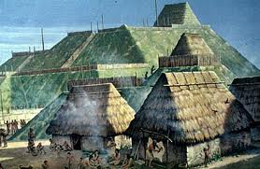

Slide 8
Cahokia
Urban cluster of about 30,000 people
Its farm fields were made up of corn, beans, and pumpkins, crops Europeans had never seen
There was a temple, a huge pyramid, covered 15 acres at its base and rose up to about 10 stories high
On the top were sacred residences of chiefs and priests
A wall surrounded the ceremonial core of the city
thousands of homes formed neighborhoods
20,000 residents more populous than London.
Had a huge central plaza, like a downtown.
With pyramids and platforms
Thousands of homes in the area formed neighborhoods

Slide 9
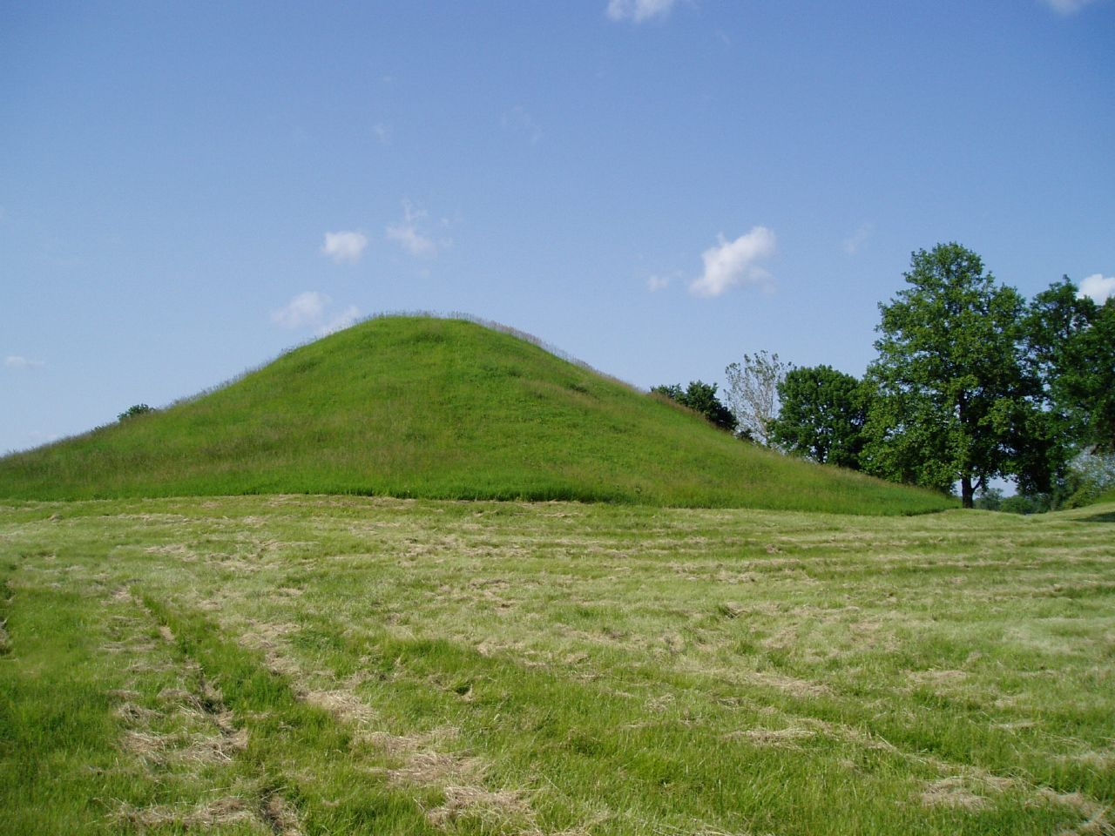

Slide 10
5 terms
Pueblos- communities that consisted of apartment-like structures made from stone, adobe mud, and other local material. These structures were usually multi-storied buildings surrounding an open plaza and were occupied by hundreds to thousands of Pueblo People.
Fertile land- Producing fruit or vegetation in abundance; fruitful able to produce abundantly.
Urban- Of, relating to, or located in a city.
Temple- A building dedicated to religious ceremonies or worship.
Noble- Having or showing qualities of high moral character, such as courage, generosity, or honor.

Slide 11
Two people that pertain to architecture
Samuel de Champlain- in 1605, he helped establish the outpost of Port Royal on what is now Nova Scotia, he also found the town of Quebec at a site strategically located so that he could intercept the traffic in furs to the Atlantic.
Pope of San Juan Pueblo- Spanish rule of the Pueblo Indians of the Rio Grande valley of New Mexico began in 1598. Although they numbered 40,000 to 80,000 people at that time, the many independent towns, often speaking different languages and hostile to each other were unable to unite in opposition to the Spanish.

Slide 12
10 multiple choice questions for chapters 1-3

Slide 13
1. What was the name of the home the Anasazis lived in?
mud house’s b the manor house c pueblos d flannels answer-c
2. what were the Anasazi’s walls constructed with?
A bricks b wood c concrete d metal answer- a
3.What were the Anasazis known for?
defeating a clan of aliens b their pottery c their women d their pets answer- b
4. With the buildings that the French built, what part of France did it resemble?
A northern b southern c eastern d western answer- a
5. what culture constructed large platform mounds or earthwork pyramid mounds?
A the Egyptians b the French c the Italians d the Mississippians
Answer- d

Slide 14
6. the mound could be found as a square, rectangular or sometimes a/an ___________ shape?
A circular b octagon c ugly d pentagon answer-a
7.one of the two examples of what was constructed on top of these mounds is…
A a cross b statue c burial buildings d a plaque of who was buried in them. Answer-c
8. How many stories high was the Cahokia pyramid?
A 3 b 4 c 9 d 10 answer- d
9 what surrounded the ceremonial core of the Cahokia city?
A moat b. wall c forests’ d the French! Answer-b
10. What was on top of the Cahokia pyramids?
A names of every tribe member b sacred residences of chiefs and priests c. fountain of youth d sacred fruit answer- b

Slide 15
Reference/ works cited:
Out of Many Author- John Faragher, Mari Jo Buhle
http//:www.wikipedia.org
http//:www.thefreedictionary.com

Slide 16
Chapters 4-6

Slide 17
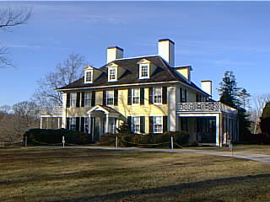
Slave plantations 1700’s- page 86

Slide 18
On the slave house on rice plantations, had steep roofs on the slave cabins, which is an African architectural feature introduced in America by slave builders.
Kept living quarters cool down by allowing the heat to rise and dissipate in the rafters.
Dark colored roof which I assume was used to make the heat rise up easier to escape through the rafters.
Built in 1714 by Thomas Broughton.
one of the earliest plantation homes in the United States
Very small compared to the manor house.
Appears to be a dark green as the roof and a light brown as the rest of the cabin.
No windows in the cabins.
Cabins appear as huts, brought design from Africa.
Manor house is more than triple the size of each individual cabin.
Also has a dark roof and light colored walls.
Many windows.
Has a steep rood for either the heat as well or can be for snow to fall off easier. Depending on where this plantation is located
As well as the cabins, the manor house appears to have a couple rafters.
Two stories, most likely brought the design from Britain.
Manor house is placed facing the cabins, I believe this is so the owner or “master” can see what the slaves are doing.
Built in 1714 by Thomas Broughton.
One of the earliest plantation homes in the United States.

Slide 19
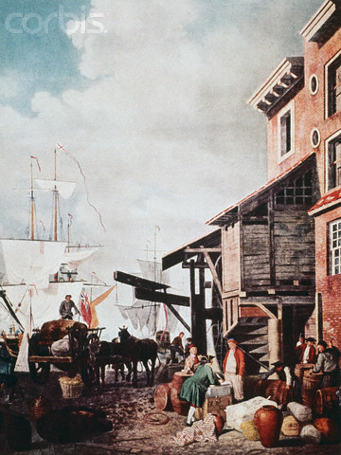
Architecture of London’s old Custom house Quay- page 93

Slide 20
Made mostly of bricks to stay strong for storms or floods.
Built high up not across to avoid possible floods from storms.
Slanted roof to allow rain to fall off easily to prevent leaks in roof.
Multiple windows for light to pass through
Also built up to be able to spot incoming ships to dock on the port.
Partially made of wood
Located directly on the seawall.

Slide 21
Kahnawake architecture- page 105

Slide 22
Community of Catholic Indians that lived like Deerfield, located in Montreal.
Farming town of about fifty or sixty homes clustered around a central church.
Surrounded by stockade to protect it from enemy raiders.

Slide 23
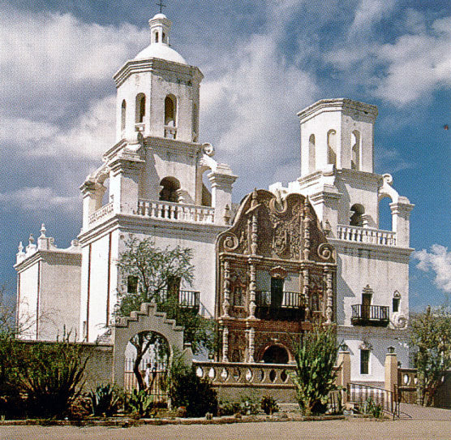
Church of San Xavier del Bac- Page 110

Slide 24
Acclaimed as the most striking example of Spanish colonial architecture in the United States.
Has a white, Moorish- inspired design.
Decorated Entrance
No records of the architect, builders, craftsmen and artisans responsible for creating and decorating it are known.
Labor was provided by Indians, and many believe they provided most of the artisans as well.
Interior is decorated with ornaments.

Slide 25
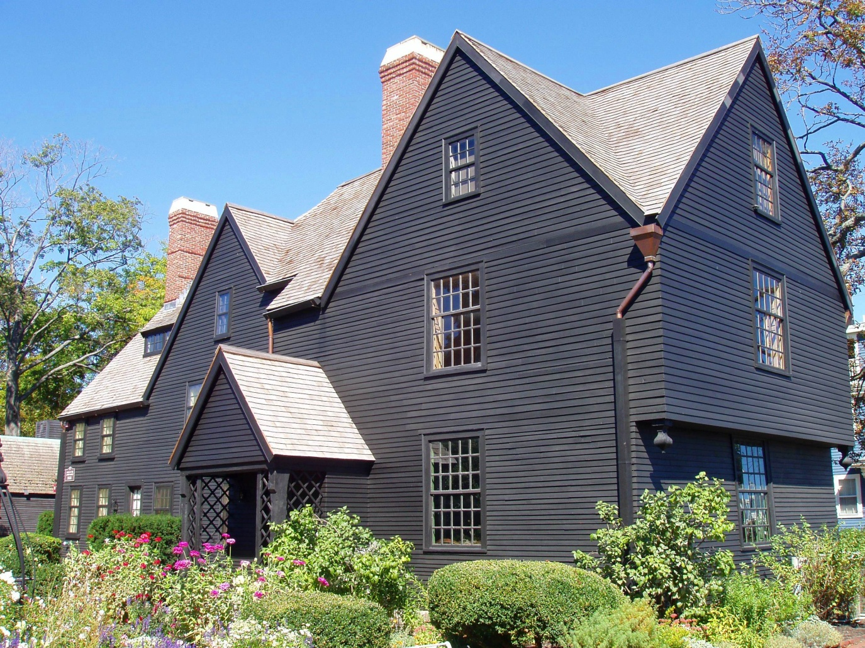
The house of the Seven Gables in Salem- page 113

Slide 26
Constructed in 17th century
“In this style of Architecture, function prevailed over form as structures grew to accommodate their residents”
Rooms were added where and when they were needed
Style came from England
Wood for building was scarce, but the abundance of forests in north America created the conditions for an age of wood construction.
Very steep roofs to prevent snow damage, allowed snow to easily slide off to not break roofs
Multiple stories high
Made out of dense wood
Has a couple of chimneys made of what appears to be bricks, for the winters to provide warmth
Many windows

Slide 27
5 terms that pertains to architecture
Rafters- one of a series of sloped structural members (beams), that extend from the ridge or hip to the down slope perimeter or eave, designed to support the roof deck and its associated loads.
Manor House- The main house on an estate; a mansion
Seawall- An embankment to prevent erosion of a shoreline.
Stockade- A defensive barrier made of strong posts or timbers driven upright side by side into the ground
Moorish- a style of architecture common in Spain from the 13th to 16th centuries; characterized by horseshoe-shaped arches

Slide 28
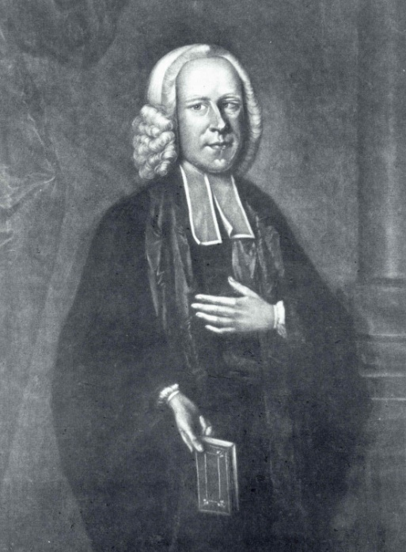
Two people that pertain to Architecture
Eunice Williams- like the other Deerfield captives, lived at Kahnawake. an English colonist taken captive by French and Mohawk warriors as a seven-year-old girl from Deerfield,
Massachusetts in 1704.
Thomas Broughton- built the Mulberry plantation in 1714 and soon became the Royal governor of South Carolina.

Slide 29
Multiple choice questions

Slide 30
1. Who Built the Mulberry Plantation?
Thomas Edison b. George Washington
c. Thomas Broughton d. The boogie man
answer- c
2. What was London’s old Custom house Quay made of?
a. all wood b. all concrete c. bricks d. metal
answer-c
3. Where was the house of the Seven Gables located?
a. north pole b. Salem c. Boston d Manhattan
answer- b
4. The Church of San Xavier del Bac had a _______ design.
a. Moorish b. Jewish C Native American d. Yankee
answer- a
5. Where were the Kahnawake located?
a. South pole b New York c Montreal d Salem
answer is c

Slide 31
6 there were no ____ in the cabins for slaves on plantations.
A windows b doors c roofs d pets
Answer- a
7. the cabins on plantations were very ____ compared to the Manor house.
A. small b dark c large d bright
Answer- a
8 The slaves slept in ______
A comfy dorms b motels c The manor house d small cabins
answer- d
9. The cabin’s roofs were very.
A steep b flat c large d light colored
Answer- a
10. London’s old Custom house Quay was built high to protect from
A Godzilla b King Kong c mudslides d floods
Answer- d

Slide 32
Reference
Out Of Many authors- John Faragher, Mari Jo Buhle, Daniel Czitrom, and Susan H. Armitage
http://en.wikipedia.org/wiki/Rafter
http://www.wikipedia.org/Mission_San_Xavier_del_Bac
http://www.thefreedictionary.com/manor
http://www.thefreedictionary.com/seawall
http://www.thefreedictionary.com/moorish
http://en.wikipedia.org/wiki/Eunice_Williams

Slide 33
Chapters 7-8

Slide 34
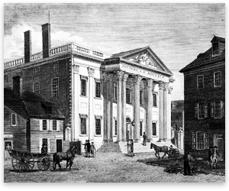
Bank of North America- 1781, page 177

Slide 35
  Samuel Blogdett made the design for the Bank of America, he was the superintendent of buildings for the capital in Washington, DC.
  Made of stone.
  Very large and tall building for its time.
  Has large pillars in the front on the steps for support of the massive building.
  Has many windows for lighting, 13 just in the front.
  Has many designs on the building such as the pillars in the front are ridged, there is a picture at the top displaying a bird and other items.
  All white.
  Has a white painted railing at the top of the roof.
  Has 2 chimneys to produce heat for the cold.
  At the top, it has engraved into it, Founded A: D: MDCCXCV.
  Has 6 pillars on the front steps.
  Tallest building in Pennsylvania at that time.
  Two stories.
  Flat roof. You didn’t have to worry about this building falling down because of snow at that time because it is so massive compared to the buildings at that time.

Slide 36
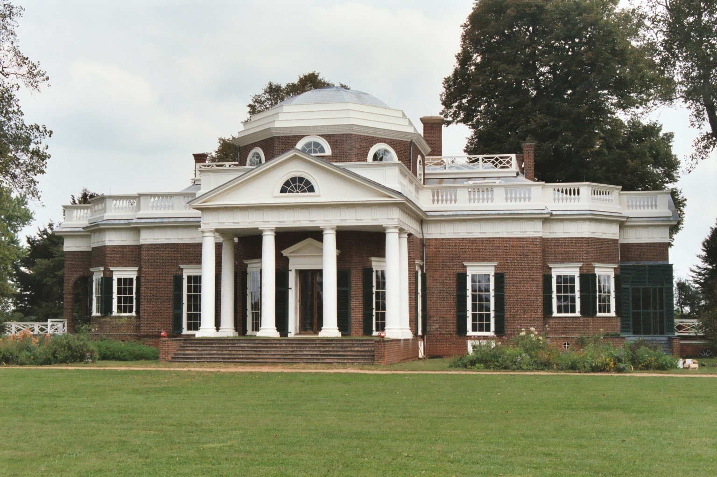
The Monticello

Slide 37
  Located in Charlottesville, Virginia
  The estate of Thomas Jefferson
  Built in 1772
  Thomas Jefferson was the architect
  Style was neoclassical architecture.
  Even the interior was all of Jefferson’s ideas himself.
  The south wing includes Jefferson's private suite of rooms.
  beds were built into alcoves cut into thick walls that contain storage space
  On the south end, there was A row of outhouse buildings and slave dwellings known as Mulberry Row.
  The house was the center of a plantation of 5,000 acres
  About 150 slaves on the plantation
  Has 6 pillars on the front steps for support
  Made of bricks with a little wood for detail outlining
  Outlining was painted white.
  Appears to have a basement as well as a balcony on the second floor.

Slide 38
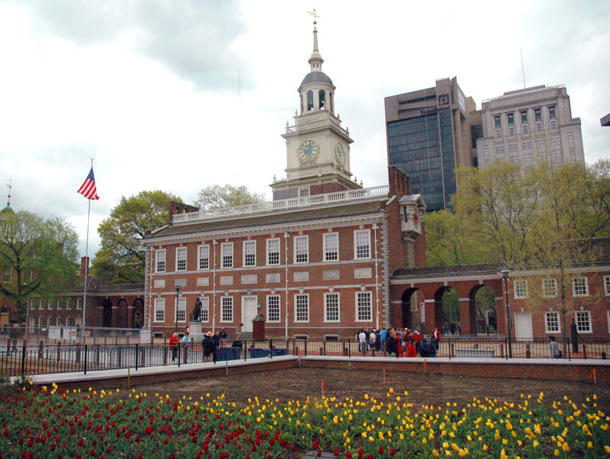
Independence hall/ State House

Slide 39
  located in Philadelphia, Pennsylvania
  location where both the Declaration of Independence and the United States Constitution were debated and chosen.
  Also called the State house.
  completed in 1753
  Was the meeting place for the Second Continental Congress from 1775 to 1783
  Home to the liberty bell
  Has a clock on its tower on the roof
  Main building is 2 stories high with multiple windows.
  Made of bricks
  designed with a Georgian style
  designed by Edmund Woolley and Andrew Hamilton
  Built by Edmund Woolley
  135 feet tall(from highest point)

Slide 40
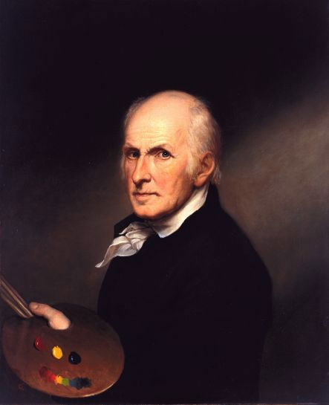
Charles Willson Peale

Slide 41
  Born April 15, 1741, died February 22, 1827
  American painter, and naturalist.
  born in Chester, Maryland
  1776, Peale painted portraits of American notables and visitors from overseas on the capital of Pennsylvania.
  organized the first U.S. scientific expedition in 1801.
  Owned a museum, Philadelphia Museum, and was later renamed the Peale Museum
  Has many notable works.

Slide 42
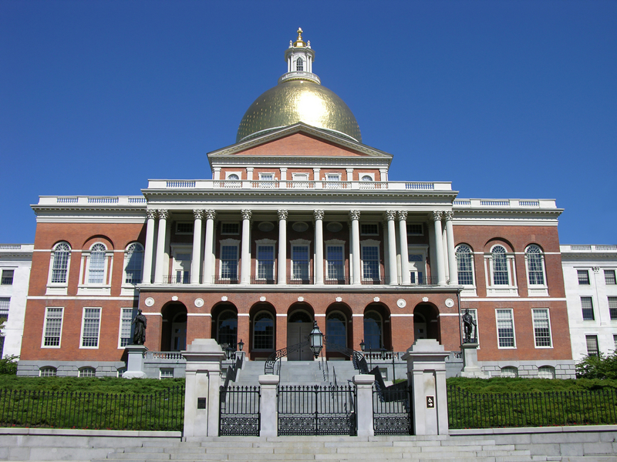
Massachusetts State House

Slide 43
  Located in Boston, Massachusetts
  Built in 1795
  The building is on 6.7 acres of land
  It was built on land once owned by John Hancock
  Charles Bulfinch was the architect
  Inspired by two London buildings, William Chambers's Somerset House, and James Wyatt's Pantheon.
  The dome, at the top, was originally made of wood. But leaked, so it was covered with copper.
  The dome was first painted gray
  Made of bricks.
  The dome is now gilded in 23 karat gold.
  The second floor under the dome is decorated by murals
  2 stories tall with many windows.
  Has a federal architectural style.

Slide 44
Two people that pertain to architecture
Thomas Jefferson- the third President of the United States, and the principal author of the Declaration of Independence. Also the architect for his building, the Monticello.
Benjamin west- first American to achieve prominence in the artistic world of Europe. The second president of the Royal Academy in London. Painted Benjamin Franklin’s portrait.

Slide 45
5 terms
  Pillar- architectural element similar to a column in its role as a vertical support structure, but the base section is any shape but circular.
  neoclassical architecture- an architectural style produced by the neoclassical movement that began in the mid-18th century.
  Portrait- a painting, photograph, sculpture, or other artistic representation of a person.
  Debate- a formal method of interactive and representational argument.
  Gild- decorative technique for applying fine gold leaf or powder to solid surfaces such as wood, stone, or metal to give a thin coating of gold.

Slide 46
Multiple choice questions

Slide 47
1. Who made the design for the bank of America?
William forge b. Samuel blogdett c. George Washington d none of the above answer- b
2. what was the bank of north America made out of?
A metal b wood c brick d stone answer- d
3. what state is the Monticello located in?
A Florida b Virginia c New york d new jersey answer –b
4. about how many slaves lived on the Monticello plantation?
A 23.5 b 55 c 5000 d 150 answer- d
5. What state is the State house located in?
A Pennsylvania b Florida c new york d none of the above answer- a

Slide 48
6 what another name for the state house?
A. the big cumfy couch b independence hall c hall of ordinance d a and c answer- b
7 what is the state house made of?
A wood b stone c tiles d brick answer- brick
8 what is the State house home to?
a. Boston fans b. liberty bell c declaration of independence d all the above answer- b
9 Originally, what was the dome of the Massachusetts’ state house made of?
A wood b silver c gold d monkey skin answer- a
10. what color was the dome first painted?
A grey b purple c red d blue answer- a

Slide 49
Reference
Out of many, Authors- John Faragher, Mari Jo Buhle, Daniel Czitrom, Susan H. Armitage
Http://www.wikipedia.org
http://www.freedictionary.com
http://en.wikipedia.org/wiki/First_Bank_of_the_United_States
http://upload.wikimedia.org/wikipedia/commons/a/a2/Thomas_Jefferson's_Monticello_Estate.jpg

